Slide 1

ECEN 361
Real-Time and Embedded Systems
Interrupts

Slide 2
Embedded systems software
How is embedded SW different than desktop SW?
Embedded SW has a different set of issues than desktop
work directly with the hardware
Multitask - do several functions simultaneously
respond to external events (button presses, sensor readings, etc)
cope with all unusual conditions without human intervention
meet strict processing deadlines – can’t just hang for a little while
never fail

Slide 3
Definition
What do you think the term real time embedded system means?
An embedded real-time system is a system that must satisfy explicit response-time characteristics or risk severe consequences, including failure
If a deadline is not met, system failure may result (plane crashes, nuclear plant goes critical, ... )
Many embedded systems can be classified as real-time based on this definition
Depends on criticality of deadlines

Slide 4
Classification of RT systems
Key question: how critical are the deadlines?
Soft RT
missing deadline causes performance degradation, but system is still functional
Firm RT
occasional deadline can be missed for a functional system
Hard RT
missing deadline causes system failure
What would be some examples of these?

Slide 5
Embedded Software Architectures
What are the 4 different embedded software architectures?
Round-Robin
Round-Robin with Interrupts
Functions Queue Scheduling
Real Time OS
Which of these could be considered real-time?

Slide 6
Interrupts
Essential in meeting hard deadlines with multiple tasks that need to run
What is an interrupt?
Interrupt’s are a nifty collaboration between hardware and software
Both are essential
Understanding details is an essential part of computer system literacy

Slide 7
Computer Interrupts
What can cause an interrupt in a computer?
Arrival of data from an I/O device
Completion of a previous request to an I/O device
Change in sensor data
Action by a human – mouse, keyboard, etc
Detection of an error condition
external (hardware configuration specific)
internal to processor, known as exceptions
Examples: divide by zero, overflow, segmentation fault
Timer expires
Power failure
Let’s start here: What does a processor do when an interrupt is asserted?

Slide 8
Interrupts: Hardware Side
Simple model:
• Interrupt pin is asserted
• HW saves information
about current task
• HW sets PC to start of
corresponding interrupt
service routine
Questions:
• Is delay possible after interrupt assertion?
• Finish current instruction - how long can this take?
• Interrupts may be masked - re-enabled under software control; max wait is up to software
• What information? Where saved?
• At least return address
• On stack, in register, in fixed
memory location, etc.
• Which is correct ISR, and where
is it in memory?
• SW must give this info to HW - usually a table of ISR starting addresses, indexed by interrupt number or level
ISRs are basically hardware induced function calls

Slide 9
Interrupt Service Routine
Interrupt Service Routine
Saving the Context
Program Counter – so we can get back
Stack Pointer – So we know how we got there
Internal Register States

Slide 10
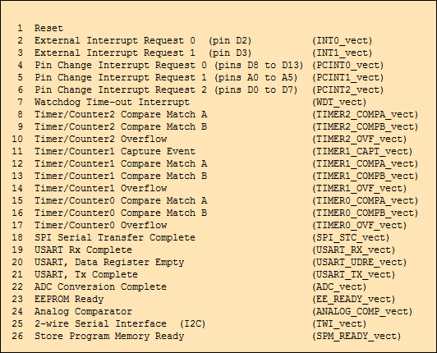
Interrupt Vector Table
Interrupt Vector Table
What function runs when which interrup occurs?

Slide 11
Interrupt Service Routine
Stack Pointer – So we know how we got there
Call Stack
main()
int value1
int value2
foo()
foo1

Slide 12
Interrupt Service Routine
int foo()
{
int foo1;
<- Interrupt Occurs here.
int main()
int value1;
int value2;
foo();
.

Slide 13
2 scenarios for interrupts
Is there anything special about these output pins
These need to be open-collector outputs – with pull-up resistor
INTR
CPU
Device 1
Device 2
Device 3
INTR1
INTR2
CPU
INTR3
Device 1
Device 2
Device 3

Slide 14
Identifying source of interrupt
Simplest hardware model: single interrupt line
How does the CPU know who interrupted it?
Single ISR for all interrupts
ISR Address is located in a register
Single location required to hold return address
Typically also in a register
Software must run down checklist: who interrupted me?
Poles hardware to see who asserted interrupt
What is good and bad of this?
Other interrupts disabled as ISR runs
CPU
Device 1
Device 2
Device 3

Slide 15
Multiple interrupt lines
More complex hardware: multiple interrupt lines
How does the CPU know who interrupted it?
For interrupt i, hardware gets entry i from table of n ISR addresses
software responsible for initializing the table
table is called interrupt vector table (IVT)
appropriate ISR can begin to run directly
Return addresses stored on stack
What is good and bad of this?
Software complexity – needs complicated boot code to init IVT
INTR1
INTR2
CPU
INTR3
Device 1
Device 2
Device 3

Slide 16
Multi-Interrupt Challenges
INTR1
INTR2
CPU
INTR3
Device 1
Device 2
Device 3
What if two lines are asserted at same time?
Need a priority scheme to determine which interrupt is more important
What if higher priority interrupt comes while lower-priority handler is running?
Nested interrupts
How does the processor handle nested interrupts?

Slide 17
Interrupt Nesting
Code Running on Processor
Priority
ISR2
ISR1
ISR1
Task
Task
Time

Slide 18
Round Robin with Interrupts
while(1)
{
if (flagA) {
flagA = 0;
handle_eventA();
}
if (flagB){
flagB = 0;
handle_eventB();
}
if (flagC){
flagC = 0;
handle_eventC();
}
}
ISR_A
{
!! do some A stuff
flagA = 1;
}
ISR_B
{
!! do some B stuff
flagB = 1;
}
ISR_C
{
!! do some C stuff
flagC = 1;
}
Work split between ISR
and task code.
In general, how long should ISR’s be? Why?

Slide 19
RR with Interrupt - Code Example
static int iTemperatures[2];
void interrupt ReadTemperatures (void)
{
iTemperatures[0] = // read in value from HW
iTemperatures[1] = // read in value from HW
}
void main (void)
{
int iTemp0, iTemp1;
while (TRUE)
{
iTemp0 = iTemperatures[0];
iTemp1 = iTemperatures[1];
if (iTemp0 != iTemp1)
// Set off howling alarm;
// Do other processing
}
}
Assume interrupt asserted at regular intervals, based on a timer, or when either temperature changes.
What does this code do?

Slide 20
Code Example
static int iTemperatures[2];
void interrupt ReadTemperatures (void)
{
iTemperatures[0] = !! read in value from HW
iTemperatures[1] = !! read in value from HW
}
void main (void)
{
int iTemp0, iTemp1;
while (TRUE)
{
iTemp0 = iTemperatures[0];
iTemp1 = iTemperatures[1];
if (iTemp0 != iTemp1)
!! Set off howling alarm;
!! Do other processing
}
}
What can go wrong?
Suppose the interrupt occurs here

Slide 21
Problem
Possible scenario in example code:
Temperature rising: one reading 80, the next is 81.
Interrupt occurs between reading temps separately.
Values are different in test in main(), although in ISR they were identical at every reading.
Howling alarm set off, needlessly
How can you fix this?

Slide 22
Is the problem fixed?
static int iTemperatures[2];
void interrupt vReadTemperatures (void)
{
iTemperatures[0] = !! read in value from HW
iTemperatures[1] = !! read in value from HW
}
void main (void)
{
while (TRUE)
{
if (iTemperatures[0] != iTemperatures[1])
!! Set off howling alarm;
}
}

Slide 23
Consider the Assembly Language Sequence
static int iTemperatures[2];
void interrupt vReadTemperatures (void)
{
iTemperatures[0] = !! read in value from HW
iTemperatures[1] = !! read in value from HW
}
void main (void)
{
while (TRUE)
{
if (iTemperatures[0] != iTemperatures[1])
!! Set off howling alarm;
}
}
….
mov r1, (itemperatures[0])
mov r2, (itemperatures[1])
cmp r1, r2
je okay
; set off alarm
okay: ….

Slide 24
Ensuring Correctness
Assembly code for other platforms will be similar
Key point: will the two values be accessed by a single machine instruction?
If not,
There is nothing to prevent an interrupt from coming between the two memory reads
The howling alarm may be set off incorrectly

Slide 25
Shared Data Problem
When does this type of problem arise?
When data is shared between the ISR and the task code that it interrupts, and when the data can appear to be in an inconsistent state when ISR runs at the wrong time
Does the bug manifest itself consistently?
No, appears randomly, with low probability
Would you catch it with thorough testing?
Not necessarily; exhaustive testing generally impossible
Testing shows the presence of bugs, but cannot prove absence
Only real solution: write bug-free code
Think long and hard about correctness of code at all levels
Stick with basic principles that work
So, one more time, how could we solve this?

Slide 26
Better Solution – Disable Interrupts
static int iTemperatures[2];
void interrupt vReadTemperatures (void)
{
iTemperatures[0] = !! read in value from HW
iTemperatures[1] = !! read in value from HW
}
void main (void)
{
while (TRUE)
{
if (iTemperatures[0] != iTemperatures[1])
!! Set off howling alarm;
}
}
….
cli
mov r1, (itemperatures[0])
mov r2, (itemperatures[1])
sti
cmp r1, r2
je okay
; set off alarm
okay: ….

Slide 27
A “C” Solution
static int iTemperatures[2];
void interrupt vReadTemperatures (void)
{
iTemperatures[0] = !! read in value from HW
iTemperatures[1] = !! read in value from HW
}
void main (void)
{
int iTemp0, iTemp1;
while (TRUE)
{
disableInterrupt();
iTemp0 = iTemperatures[0];
iTemp1 = iTemperatures[1];
enableInterrupt ();
if (iTemp0 != iTemp1)
!! Set off howling alarm;
}
}
A Blackfin solution:

Slide 28
Backup

Slide 29
Shared Data
Defn - Critical Section: a section of code that cannot be interrupted for correct operation
Need to remember the shared data problem can arise when task code shares data with ISR’s,
Lines of C-code rarely map to single instructions
Disabling and then re-enabling interrupts is really the only way around this

Slide 30
What can go wrong here? How to fix?
static int iSeconds, iMinutes, iHours;
void interrupt vUpdateTime (void)
{
++iSeconds;
if (iSeconds >= 60)
{
iSeconds = 0;
++iMinutes;
if (iMinutes >= 60)
{
iMinutes = 0;
++iHours;
if (iHours >= 24)
iHours = 0;
}
}
!! Do whatever needs to be done to the HW
}
long lSecondsSinceMidnight(void)
{
return (((iHours * 60) + iMinutes) * 60) + iSeconds;
}

Slide 31
One Solution
static int iSeconds, iMinutes, iHours;
void interrupt vUpdateTime (void)
{
++iSeconds;
if (iSeconds >= 60)
{
iSeconds = 0;
++iMinutes;
if (iMinutes >= 60)
{
iMinutes = 0;
++iHours;
if (iHours >= 24)
iHours = 0;
}
}
!! Do whatever needs to be done to the HW
}
long lSecondsSinceMidnight(void)
{
return (((iHours * 60) + iMinutes) * 60) + iSeconds;
}
long lSecondsSinceMidnight(void)
{
long lRetVal;
disableInterrupts ();
lRetVal = (((iHours * 60) + iMinutes) * 60) + iSeconds;
enableInterrupts ();
Return lRetVal;
}
What can go wrong with this solution?

Slide 32
One Solution
static int iSeconds, iMinutes, iHours;
void interrupt vUpdateTime (void)
{
++iSeconds;
if (iSeconds >= 60)
{
iSeconds = 0;
++iMinutes;
if (iMinutes >= 60)
{
iMinutes = 0;
++iHours;
if (iHours >= 24)
iHours = 0;
}
}
!! Do whatever needs to be done to the HW
}
long lSecondsSinceMidnight(void)
{
long lRetVal;
disableInterrupts ();
lRetVal = (((iHours*60)+iMinutes)*60)+iSeconds;
enableInterrupts ();
Return lRetVal;
}
void main (void) {
while (TRUE){
:
:
disableInterrupts ();
:
time = lSecondsSinceMidnight();
:
enableInterrupts ();
:
}
}
What is wrong here?

Slide 33
Subtle Point
What if the subroutine is called from inside a critical region of another part of the program?
interrupts will be re-enabled
not what you want at that point
How could you fix this?

Slide 34
Another Approach
static long int secondsToday;
void interrupt updateTime (void)
{
...
++secondsToday;
if (secondsToday == 60 * 60 * 24)
secondsToday = 0L;
...
}
int main (void)
{
long value;
value = secondsToday;
:
:
display (secondsToday);
:
:
}
Is there any problem with this main loop?
For efficiency, the variable secondsToday will be saved in a register when it is assigned to value. It will not re-read the memory location in the call to display(). The register value will be passed to the display function.

Slide 35
Another Approach Discussion
Problem: a good (optimizing) compiler is smart enough to only read memory once, and keep the value in a register
Justification: no intervening write took place between the two reads, so value in register still okay.
What is the solution?
Solution: use “volatile” keyword to inform the compiler that special handling is required.
Forces compiler to read memory every time the variable is accessed and not to make “obvious” optimization.
“Volatile” says variable is subject to change from something the compiler is not aware of.
static volatile long int iSecondsToday;

Slide 36
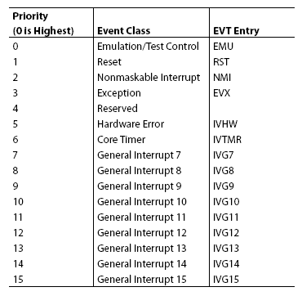
Blackfin Interrupt Model
16 Core Event Classes
Emulation
Reset
NMI
Exception
Interrupts
Hardware Error
Core Timer
IVG7 – IVG15
3 Registers are used to control and coordinate events
ILAT, IMASK, IPEND
Description of Interrupt functionality is shown in chapter 4 of the HRM

Slide 37
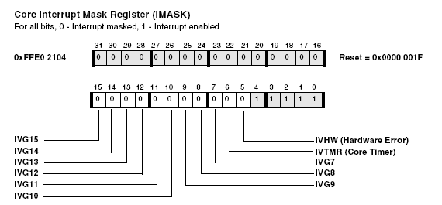
IMASK Register

Slide 38
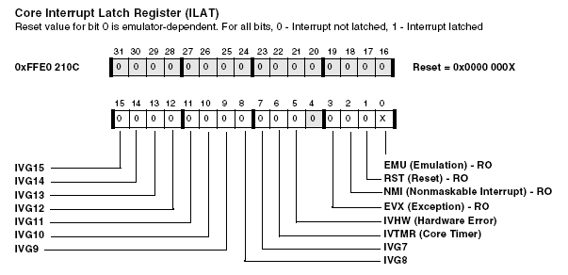
ILAT Register

Slide 39
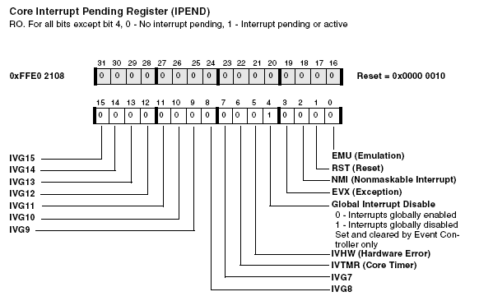
IPEND Register

Slide 40
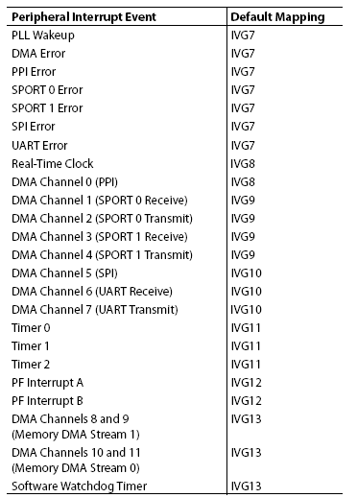
Blackfin 533 Interrupt Model
Default Peripheral Interrupt Mapping
Multiple interrupt sources for each interrupt group
Can remap interrupts depending on application
3 Registers are used to control and coordinate events
SIC_IMASK, SIC_ISR, SIC_IWR

Slide 41
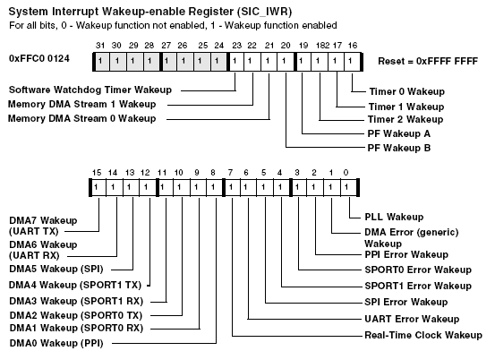
SIC_IWR register

Slide 42
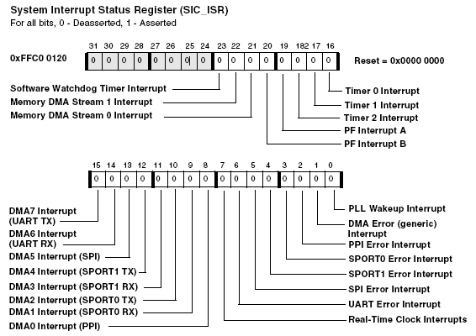
SAC_ISR Register

Slide 43
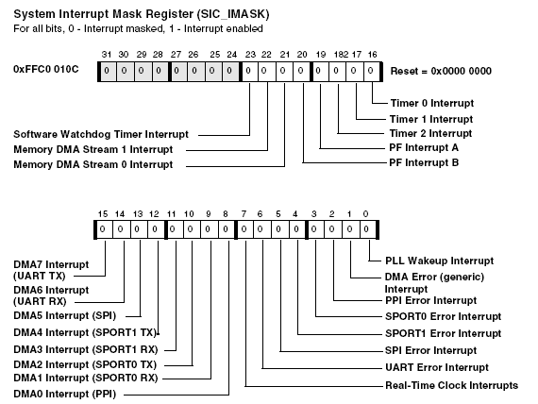
SIC_IMASK Register

Slide 44
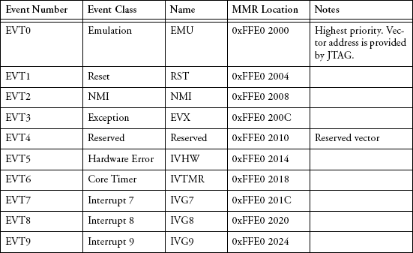
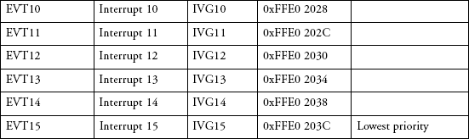
Interrupt Vector Table

Slide 45
Setting up Interrupts
The main steps for setting up interrupts are:
Create the interrupt service routines.
Initialize the vector table and set up the vectors in the memory map.
Enable the interrupt
The HRM document describes the entire ISR process

Slide 46
Interrupts - Key to Responsiveness
Essentially all processors respond to interrupts.
Part of our focus this semester:
Systems with challenging response-time constraints
Getting the right answer is important, but it must be delivered when it is required
Are there systems in which timeliness is not important?
Implication: sometimes timely response time is critical.
consequences far worse than (just) an unhappy user

Slide 47
Hard Real Time Systems
Assumed unless explicitly stated otherwise
Deadlines must be met!
These are the most demanding real-time systems to design
We learn the most looking at the demands of meeting hard deadlines
If you can meet hard RT constraints, others can certainly be met, since constraints can be relaxed

Slide 48
Interrupt Basics
Interrupts: a mechanism used to transfer attention to something of potential importance
Interrupts for humans:
Doorbell, phone, oven timer (pizza done!)
Do you sometimes ignore these interrupts?
Fundamental scenario in real-time systems:
processor is running job A
something happens that must be dealt with
processor must put A “on hold”, handle event

